Slide 1
DETECTING FAKE NEWS USING DATA ANALYTICS
Joon Park
November 30, 2021
Notes:
Hello everyone! Today we will be presenting on how organizations can use data analytics to detect fake news.

Slide 2
Agenda
01
02
03
04
05
06
Background
Data
Analysis
Insights
Business Strategies
Questions

Slide 3

WHAT IS FAKE NEWS?
Fake news is false or misleading information that is presented as factual news
Generally spread through social media and other online media platforms
Usually fake news is presented to impose certain ideas onto people or with a political agenda

Slide 4
Impacts of Fake News
Impacts People’s Relationship with the Government
Influences People’s Beliefs and Actions
Increased Engagement with Polarizing Issues
Approximately 70% of Americans believe that fake news has affected their level of confidence in the government
Studies show that undecided voters were more likely to vote for a candidate in the last election if they saw fake news about the opposing candidate
Before the 2016 election, the top 20 fake news stories received more engagement than the top 20 factual news stories on social media

Slide 5
The Business Problem
PROBLEM
Social Media companies and news firms are struggling with filtering out fake news, leading to the mass spread of misinformation

Slide 6
Solution
SOLUTION
Use AI powered analytics to detect anomalies and inconsistent information to stop the spread of fake news. AI powered analytics can help solve this problem by looking to see if the headline aligns with the information presented or if anomalies are present.

Slide 7
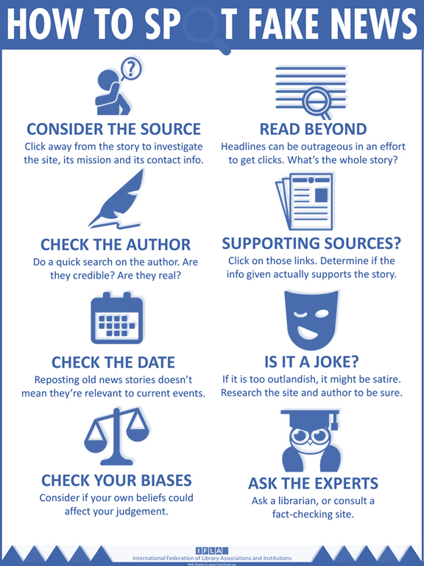
The Ways AI Detects Fake News
AI systems can evaluate the reliability comparing different features with real news stories.
Text processing to analyze the author’s writing style.
Examine similar articles on the Internet to check whether other news media mention different facts.
Compare the ratio of reactions versus shares on social media.
Consider the credibility of the source.

Slide 8
Research Objectives
Analyze the data to determine if we can accurately use analytics to detect fake news
Determine if social media companies and news outlets can utilize the analytics to combat misinformation

Slide 9
Analysis

Slide 10

Our Dataset
Two separate datasets: Fake and real news data
Includes data about news articles with columns: title, text, subject, and date.
In total, there are 44896 rows
Data from March 30, 2015 - February 18, 2018
Notes:
To begin with our coding portion of the presentation, we wanted to highlight the features of our dataset. For this project, we used two datasets, one for the real or true news and one for the fake news. Each dataset holds information about the news articles like their title, text, subject and date it was published. In total, the datasets have 44,896 lines with about 21000 for the real news dataset and about 23000 for the fake dataset. Lastly, the news articles were published between March 2015 and Feburary 2018.

Slide 11
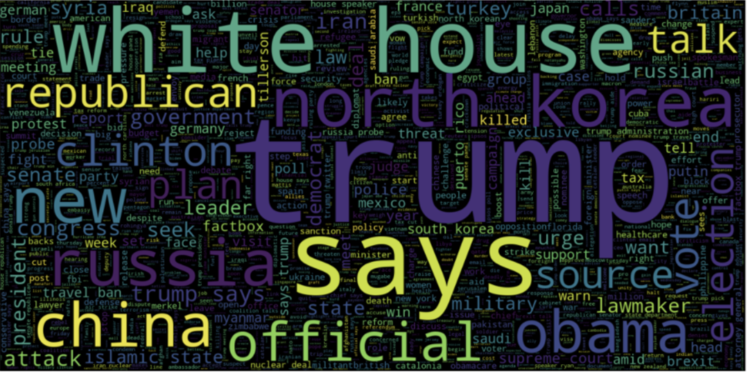
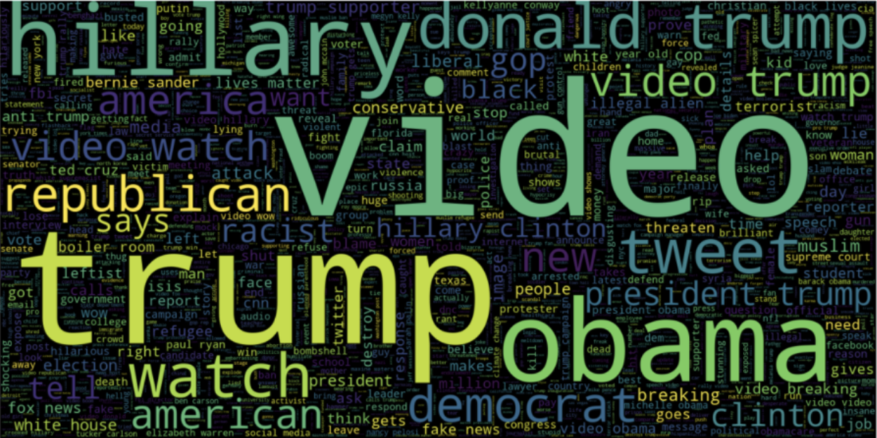
Dataset Visualizations
Real News Visualization
Fake News Visualization
Notes:
From our dataset we were able to create a world cloud for both datasets. On the right we have the word cloud for the real news and teh left is for the fake news. Both word clouds show words consistently used in the article titles. This is a great visualization because it helps understand the most commonly used words but as you can see their is a lot of overlapping, mainly about political leaders.

Slide 12
Summary table of dependent variables, independent variables, models, research objectives
Independent Variables | News Article Text
Dependent Variables | Fake(1) or Real(0)
Models | Logistic Regression, Decision Tree, Gradient Boosting Classifier, Random Forest, BERT Model
Notes:
Before we get into our analysis, we wanted to highlight both the independent and dependent variables along with the models that we used to accomplish our objective. Our independent variables were the titles and the body of the news articles and the dependent variables were the classifications of whether or not the news is fake or real. To determine this variable, we used logistic regression, decision tree, Random Forest, Gradient Boosting Classifier and the BERT model.

Slide 13
Logistic Regression on News Article Titles
Notes:
The first model we will go over includes classifiers and methods that will help the model out an accurate prediction of fake or real news.

Slide 14
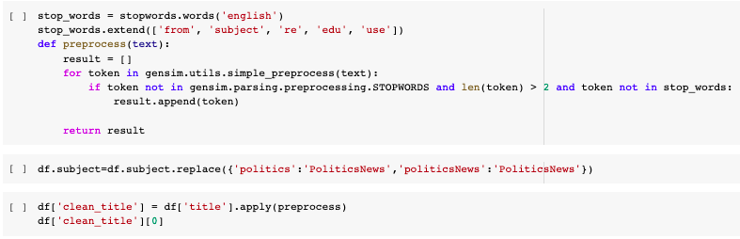
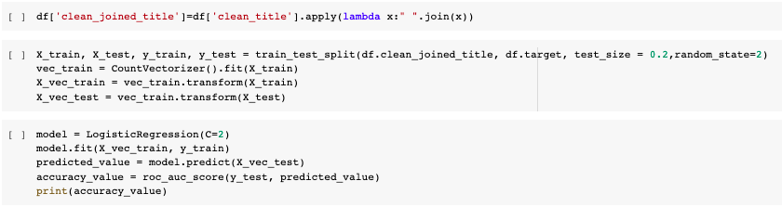
Preprocessing Data and Applying Logistic Regression
Notes:
To apply this model, we preprocessed the model and tokenized the title to make sure we are able to train the model. Then we split the model with a 80 to 20 ratio and used the logistic regression function from sklearn and fit the model to create a prediction.

Slide 15
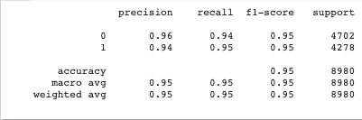
Result of Applying Logistic Regression on the Title
Notes:
Here we see that we were able to achieve a very high accuracy of 95% just by applying the machine learning methods to the article titles. This indicates to us that titles are very good indicators of determining whether or not the news is fake. Next I am going to pass it off to Sammy who is going to talk about applying different models to the BODY of the article.

Slide 16
Logistic Regression, Decision Tree, Gradient Boosting Classifier, and Random Forest Classifier Models
Notes:
The first model we will go over will use four classifiers and methods that will help our final model output a fairly accurate prediction of fake or real news. These classifiers are the logistic regression model, the decision tree model, gradient boosting classifier, and the random forest classifier.

Slide 17
Cleaning Our Datasets for This Model
Insert new column “Class” and input 0 in fake dataset and 1 in real dataset
Remove last ten rows in both datasets for manual testing
Merge the fake and real datasets together
Remove unrequired columns: title, subject, and date
Randomly shuffle the merged dataset
Notes:
For this method, we want to start by cleaning our datasets. First we must remove the last ten rows in both datasets for manual testing our model later on. So we should have about 20 rows to test our model with. Second, we need to merge the fake and real datasets together so it can all be on one file. Third, we remove any unrequited columns in our datasets. In this case, we will remove the title, subject, and date columns and only focus on the text column which holds the whole articles text. Finally the last step to cleaning our dataset, we want to randomly shuffle the merged set.

Slide 18
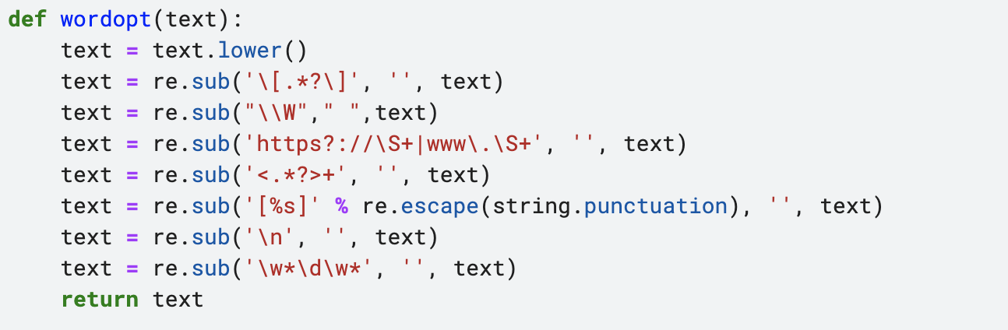
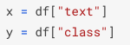
Create function to process texts and convert texts to vectors
This function will return clean text without any stop words and punctuations
Define Independent and Dependent Variables for the model
Notes:
After we clean the data, we need to go into the text column and clean the text. We created a function that will return clean text without any stop words and punctuations. Next we need to to define the independent and dependent variable for the training and test sets, so you simply set the text column to x and the class column to y.

Slide 19

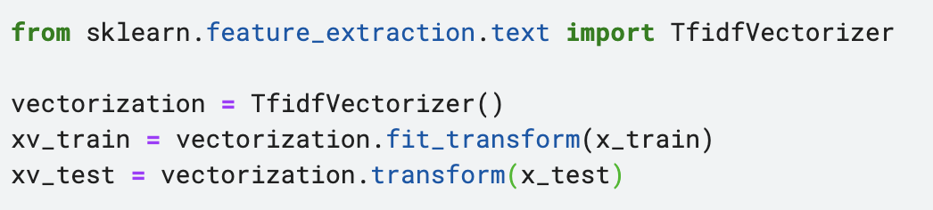
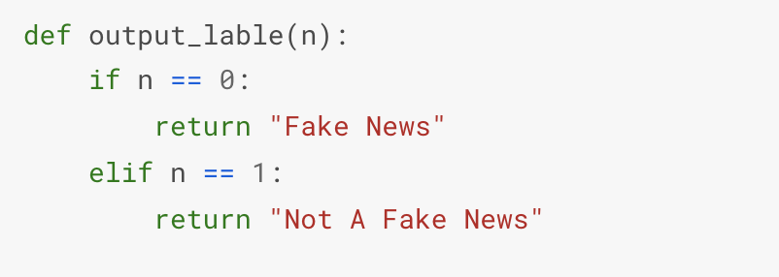
Create function to process texts and convert texts to vectors
Create training and test datasets to train the classification methods
Convert text to vectors for both the training and test set
This output label function is used in the final model
Notes:
Then, we create the training and test datasets to train the classification methods. This will help develop the classification report for the model that tells us the precision, recal, f-score, and accuracy. Like many other text analysis approach, we need to convert the text to vectors for both the training and test set. To do this, you need to import the Tfidvectorizer from feature extraction.text. Now you can fit the words from the training and test dataset into the vectorization code. Now xv_train and xv test represent your new text.

Slide 20
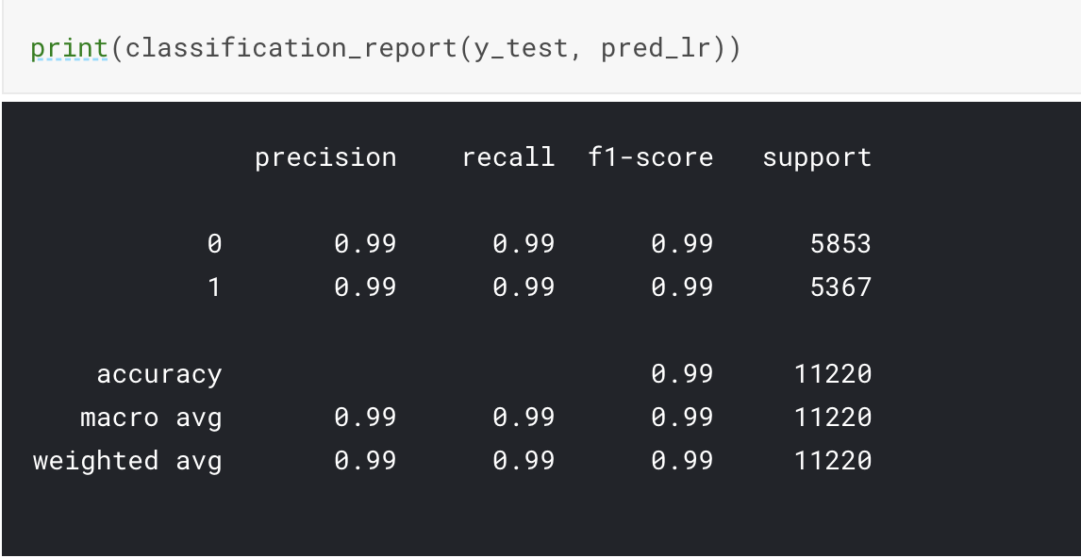
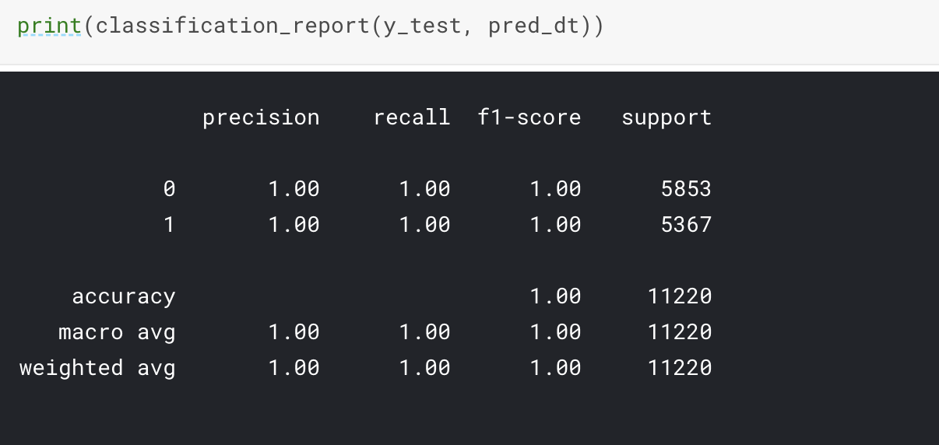
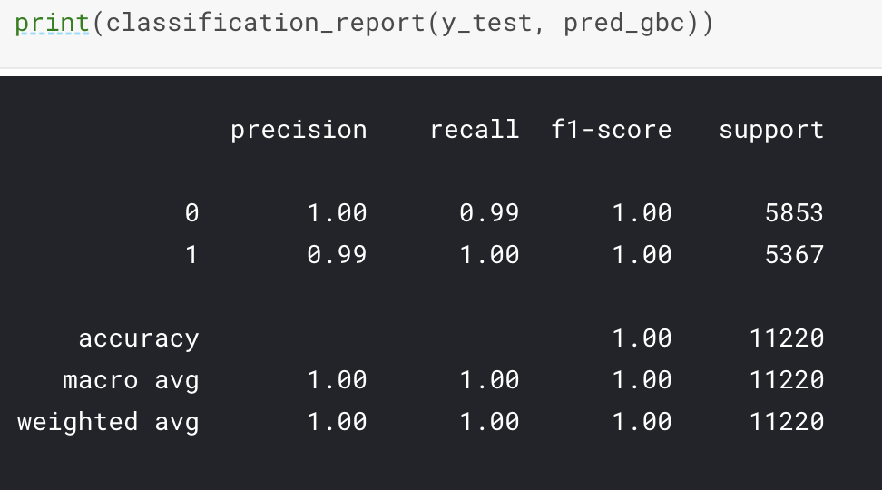
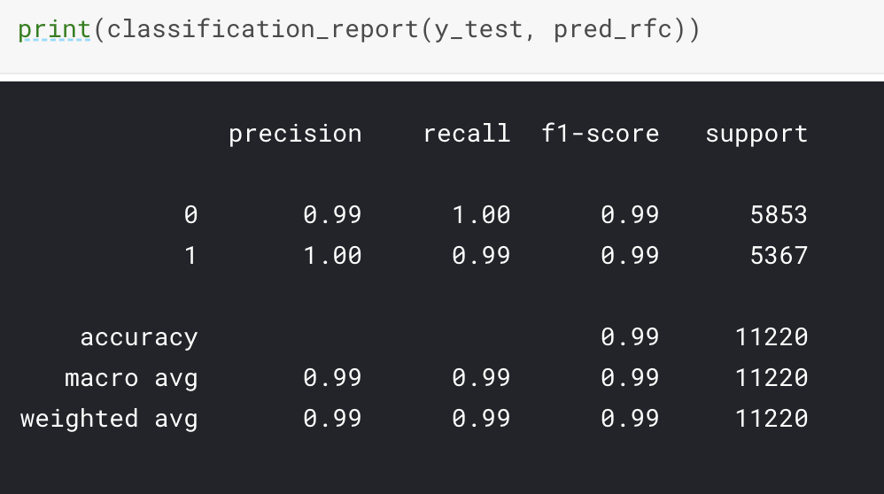
Logistic Regression, Decision Tree, Gradient Boosting & Random Forest Classifiers
01
02
03
04
Logistic Regression
Decision Tree Classification
Gradient Boosting Classifier
Random Forest Classifier
Notes:
For our final model, we want to use all four classifications methods to get a better understanding and accuracy for our final model. These softwares were imported from the sklearn library and they all use the same code structure. We imputed the code from On the screen, are the four classifiers used. The logistic regression model is used to model the probability of a certain class or event existing, for this case it is whether the text is fake or true news. The decision tree classifier builds classification or regression models in the form of a tree structure. It breaks down a dataset into smaller subsets while at the same time an associated decision tree is incrementally developed. The final result is a tree with decision nodes and leaf nodes. Gradient boosting relies on the intuition that the best possible next model, when combined with previous models, minimizes the overall prediction error. The key idea is to set the target outcomes for this next model in order to minimize the error. Lastly, the random forest classifier is a classifier that contains a number of decision trees on various subsets of the given dataset and takes the average to improve the predictive accuracy of that dataset.
On the screen, there are the classification and accuracy reports for all four methods. Out of the four methods, the decision tree and gradient boosting classification have the highest accuracy of 99.6% while Logistic regression and random forest classification still had a high accuracy of 98.6%. These classification reports show that these models are very accurate so they will be very useful for our model. These accuracies are very high and accurate so we were a bit skeptical about the accuracy of them but our test on the model proved that they were accurate.

Slide 21
Insights Drawn from the Data and Models
Accuracy
Indicators
Models
The Logistic Regression, Decision Tree classification, Gradient Boosting, and Random Forest classifier have higher accuracy
Although titles can be a good indicator of predicting whether the news is fake or real, titles are often misleading as seen by the difference in the accuracy.
It’s best to use all four models (Logistic Regression, Decision Tree, Gradient Boosting, and Random Forest) together to get a more accurate result.
Notes:
So, what insights can we draw from the data and the different models presented? First, regarding the accuracy, we can conclude with our results that the Logistic Regression, Decision Tree classification, Gradient Boosting, and Random Forest classifier have higher accuracy than the BERT model. Second, we concluded that although titles can be a good indicator of predicting whether the news is fake or real, titles are often misleading as seen by the difference in the accuracy. Third, we figured that it is best to use all four models (Logistic Regression, Decision Tree, Gradient Boosting, and Random Forest) together to get a more accurate result.

Slide 22
Applications of Fake News Detection to Businesses
Social Media companies can utilize these models to effectively take-down false posts that rapidly spread
Increase the quality of news and information that circulates on the internet
Decrease the spread of disinformation and misinformation
Notes:
Social Media companies can utilize these models to effectively take-down false posts that rapidly spread. We can then increase the quality of news and information that circulates on the internet, and ultimately decrease the spread of disinformation and misinformation.

Slide 23
Be always transparent
Find the source of misinformation
Continually monitor news and chatter around the brand
Be data-driven and empathetic
Establish an internal review team
Business Strategies for Dealing with Fake News
Notes:
Our recommendations to businesses to address the scourge of fake news is to respond with no ambiguity in order to avoid altering a company’s public image. It is therefore important for marketing leaders to constantly monitor news and chatter around their brands, to be able to immediately intervene when misleading information is discovered. Being always transparent with the issue can help build trust through authentic messaging. It is important for a company to stay data-driven, but businesses need to be empathetic at the same time because the audience wants to know what’s happening. It is crucial to be able to correct the information immediately and work quickly to determine the source of the misinformation. To respond across as many channels as possible is very important to help customers accept the issue, with newly updated message. An internal review team is a good solution to help businesses make the right decisions when confronted to fake news.

Slide 24
Key organizations to combat fake news and disinformation
Government responsibilities
News industry actions
Encourage independent and professional journalism
Avoid crackdowns and censoring
Focus on high-quality journalism
Call out fake news and disinformation
Technology company responsibilities
Educational institutions
Enhance news literacy
Individuals should follow a diversity of people and perspectives
Invest in technologies to detect fake news for users through algorithms and crowdsourcing
Notes:
Combating the problem of fake news is the responsibility of everyone. When implementing solutions, we, however, need to be careful not to apply overly restrictive regulations on internet platforms, which can encourage censorship, or even authoritarian regimes. An important thing governments have the power to do is to encourage independent and professional journalism. In the news industry, it is important that the different organizations are calling out fake news and disinformation without legitimizing them, to build trust. Through algorithms and crowdsourcing, technology companies need to invest in technologies that will detect fake news, to be able to identify it for the users. For the population to be more aware of the issues regarding fake news, it is important that educational institutions put funding efforts to enhance news literacy. It is important that the population follows a diversity of people and perspectives to be protected from false news and disinformation

Slide 25
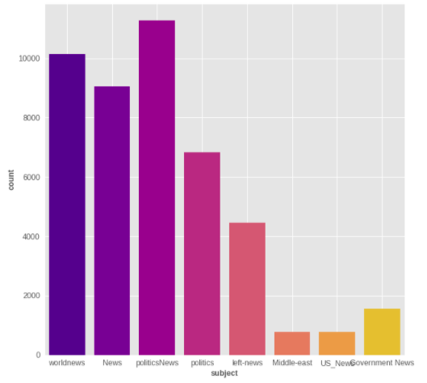
Appendix A: Distribution of Topics in the Dataset

Slide 26
References
https://www.mdpi.com/2079-9292/10/19/2326/pdf
https://www.dictionary.com/browse/fake-news
https://www.meaningcloud.com/blog/case-study-text-analytics-against-fake-news
https://www.ucf.edu/news/how-fake-news-affects-u-s-elections/
https://www.verizon.com/info/technology/fake-news-on-social-media/
https://www.brookings.edu/research/how-to-combat-fake-news-and-disinformation/
https://journals.sagepub.com/doi/full/10.1177/2053951719843310
https://www.forbes.com/sites/forbescommunicationscouncil/2020/08/25/16-business-strategies-for-dealing-with-fake-news/?sh=1bcf8fd053e8
https://www.analyticsvidhya.com/blog/2020/07/transfer-learning-for-nlp-fine-tuning-bert-for-text-classification/
https://www.analyticsvidhya.com/blog/2019/09/demystifying-bert-groundbreaking-nlp-framework/?utm_source=blog&utm_medium=fine_tune_BERT
cc

